Slide 1
Developing an Accessible Widget with ARIA
with Dennis E. Lembrée and Victor Tsaran
CSUN 2013
San Diego, CA
February 28, 2013

Slide 2
Agenda
About Us
HTML5 Support
ARIA
HTML5 vs. ARIA
Simple Example
Complex Example
Tips
Questions
Contact Info

Slide 3
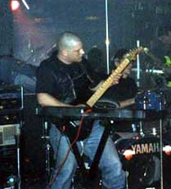

About Us
@DennisL
@Vick08
We both play guitar.
We both are married.
We both like espresso.

Slide 4

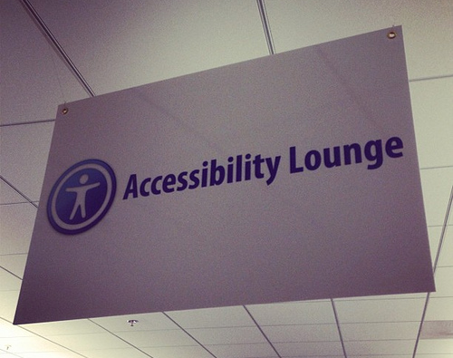
About Us
We both work on the accessibility team at PayPal.
@PayPalinclusive
Notes:
http://www.flickr.com/photos/odmag/8454251671/

Slide 5





HTML5 Support
Lots of HTML5 excitement.
Notes:
+HTML5 Developer Conference in SF

Slide 6
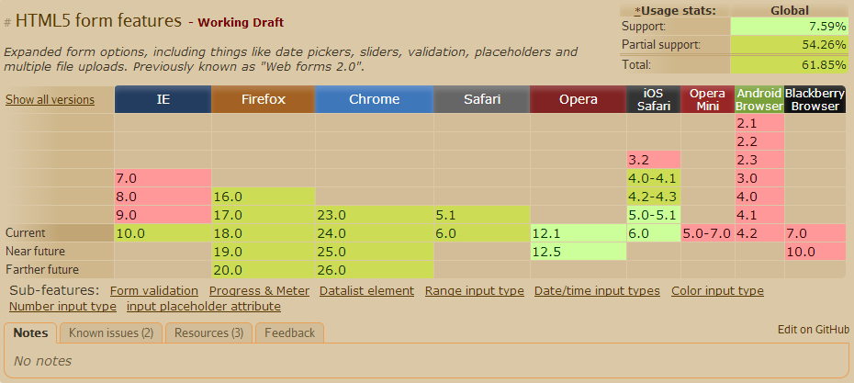
HTML5 Support
Browser support for HTML5 forms is poor.
Source: http://caniuse.com/

Slide 7
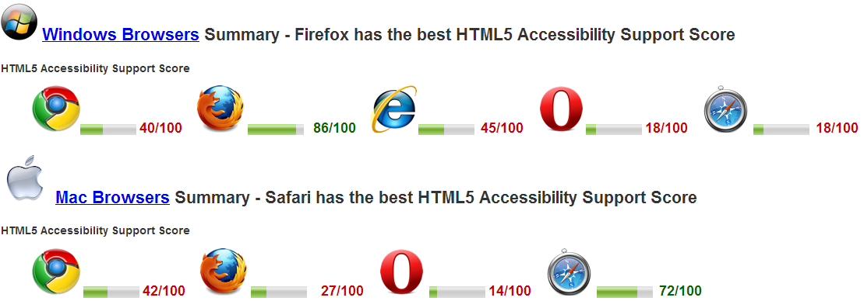
HTML5 Support
HTML5 browser accessibility is even less supported.
ARIA helps bridge the gap.
Source: http://www.html5accessibility.com
Notes:
http://www.html5accessibility.com/
https://docs.google.com/presentation/d/1VCOM0TDZ3IxtDAc3GzR4Z58MhKIA9nAk4fA8f-7D058/present

Slide 8
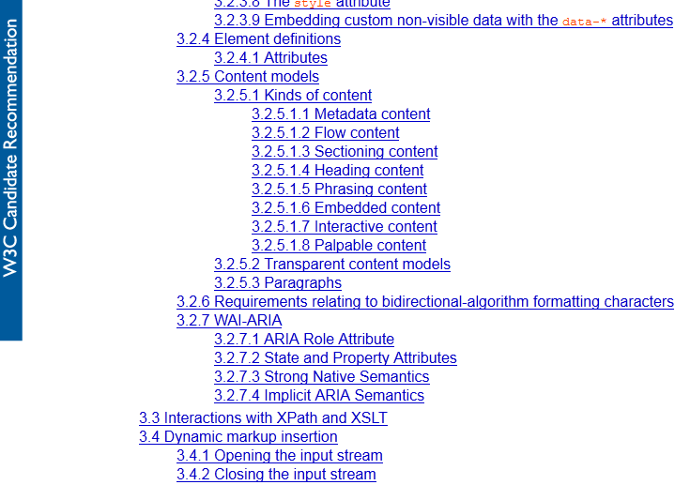
ARIA
ARIA is recognized in the HTML5 specification
Notes:
HTML5 W3C Candidate Recommendation: http://www.w3.org/TR/2012/CR-html5-20121217/dom.html#wai-aria
HTML 5.1 Nightly: http://www.w3.org/html/wg/drafts/html/master/dom.html#wai-aria

Slide 9
ARIA
W3C WAI-ARIA
Accessible Rich Internet Applications (WAI-ARIA) 1.0
W3C Candidate Recommendation, January 2011
“attributes that define user interface elements to improve the accessibility and interoperability of web content and applications”
Basically, ARIA helps users of screen readers and other AT with modern web technologies.
Notes:
ARIA W3C Candidate Recommendation: http://www.w3.org/TR/wai-aria/
ARIA Editors' Draft: http://www.w3.org/WAI/PF/aria/

Slide 10
ARIA
Types of attributes:
Roles
States and Properties
[Abstract roles are used for ontology. DO NOT use abstract roles in content.]
Notes:
ARIA W3C Candidate Recommendation: http://www.w3.org/TR/wai-aria/
ARIA Editors' Draft: http://www.w3.org/WAI/PF/aria/

Slide 11
ARIA
Roles
Widget roles: button, dialogue, menu, radio, tab…
Document structure: list, presentation, row, separator…
Landmark roles: banner, main, navigation…
States and Properties
Widget attributes: aria-checked, aria-expanded, aria-haspopup, aria-label, aria-readonly, aria-required
Live regions: aria-atomic, aria-busy, aria-live
Relationship attributes: aria-controls, aria-describedby, aria-labelledby, aria-owns

Slide 12

HTML5 vs. ARIA
required and aria-required
menu element vs. menu role
aria-describedby vs. longdesc (heated debate!)
aria-describedby vs. summary
structural elements vs. landmark roles (next slide)
Notes:
Menu element is not supported yet in browsers not AT. The spec: http://www.w3.org/html/wg/drafts/html/master/interactive-elements.html#the-menu-element

Slide 13
Simple example
Landmark Roles
banner (page header)
navigation (nav)
main (div main)
complementary (aside)
search (div, form)
contentinfo (page footer)
form, application (div) use with caution

Slide 14
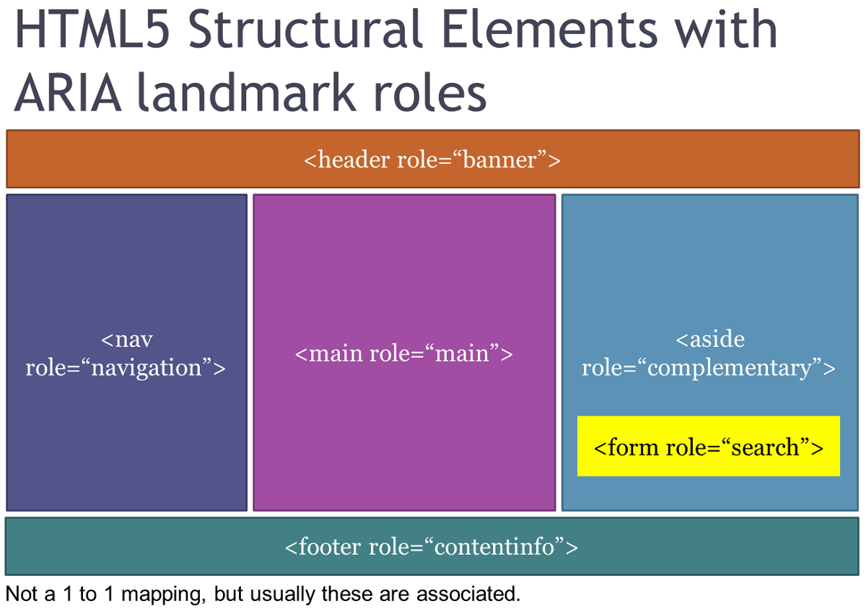
Simple example
Notes:
http://www.flickr.com/photos/odmag/8034463748/
http://www.flickr.com/photos/odmag/8467120722/

Slide 15
Simple example
Demo
To navigate by landmarks in a screen reader:
NVDA: D key
JAWS: ; key
VoiceOver: use rotor (enable landmarks in settings) or assign a hot-key

Slide 16
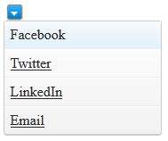
Complex example
Goals
Make dropdown button
Use semantic HTML and progressive enhancement
Follow keyboard conventions
Accessible; specifically, with keyboard and screen reader
Notes:
http://weboverhauls.com/sandbox/HTML5_DevConf_ARIA_Example/

Slide 17
Complex example
Steps
HTML (content)
CSS (presentation)
JavaScript (behavior)
ARIA (filling accessibility gaps)
Demo URL: http://bit.ly/ZvA9SH
Notes:
http://dl.dropbox.com/u/1065747/csun13/index.html

Slide 18
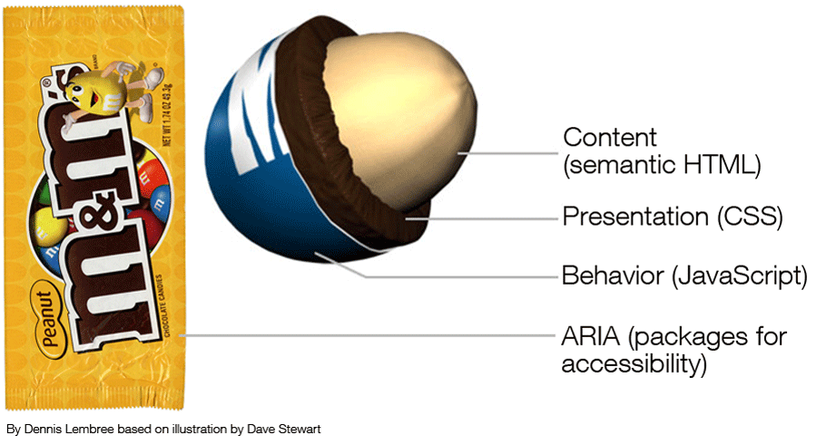
Complex example
Notes:
http://www.flickr.com/photos/odmag/8496072438/in/set-72157624925954995/

Slide 19
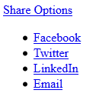
Complex example – HTML
<div>
<a>Share Options</a>
<div>
<div>
<ul>
<li><a href="http://www.facebook.com">Facebook</a></li>
<li><a href="http://www.twitter.com">Twitter</a></li>
<li><a href="http://www.linkedin.com">LinkedIn</a></li>
<li><a href="mailto:dlembree@paypal.com">Email</a></li>
</ul>
</div>
</div>
</div>

Slide 20
Complex example – HTML
<div class="dropdownMenu">
<a href="#ddMenuList1" id="ddMenu1" class="menuButton">Share Options</a>
<div aria-labelledby="ddMenu1">
<div id="ddMenuList1">
<ul>
<li><a href="http://www.facebook.com">Facebook</a></li>
<li><a href="http://www.twitter.com">Twitter</a></li>
<li><a href="http://www.linkedin.com">LinkedIn</a></li>
<li><a href="mailto:dlembree@paypal.com">Email</a></li>
</ul>
</div>
</div>
</div>

Slide 21

Complex example – CSS (partial)
.dropdownMenu {
position: relative;
display: inline-block;
}
.dropdownMenu a.menuButton {
overflow: hidden;
display: inline-block;
width: 15px;
height: 15px;
margin-left: 4px;
z-index: 5;
top: 2px;
text-indent:-999px;
-moz-border-radius:3px;
-webkit-border-radius:3px;
border-radius:3px;
}
...

Slide 22
Complex example – JavaScript (partial)
(function() {
"use strict";
$.widget("widget.dropdownMenu", {
options: {
showOn: "click"
},
_create: function() {
this._getElements();
this._updateElements();
this._addListeners();
},
_getElements: function() {
this.elements = {};
// the menu container (div role=menu)
this.elements.container = this.element.find("div:first");
},
_addListeners: function() {
...

Slide 23

Complex example – inject ARIA
Magic!
_updateElements: function() {
this.element.find('a:first').attr("aria-haspopup", "true")
.attr("role", "button");
this.elements.container.attr("role", "menu")
.attr("aria-hidden", "true");
this.element.find('div div').attr("role", "presentation");
this.element.find('ul:first').attr("role", "presentation");
this.element.find('ul:first li').attr("role", "presentation");
this.element.find('ul:first li a').attr("role", "menuitem")
.attr("tabindex", "-1");
},

Slide 24
Complex example – inject ARIA
Rendered markup:
<div class="dropdownMenuAlt showButton">
<a id="ddMenu1" class="menuButton" href="#ddMenuList1"
aria-haspopup="true" role="button" aria-expanded="true">
Share Options
</a>
<div aria-labelledby="ddMenu1" role="menu" aria-hidden="true">
<div id="ddMenuList1" role="presentation">
<ul role="presentation">
<li role="presentation">
<a href="http://www.facebook.com" role="menuitem" tabindex="-1">
Facebook
</a>
</li>
...
</ul>
</div>
</div>
</div>

Slide 25
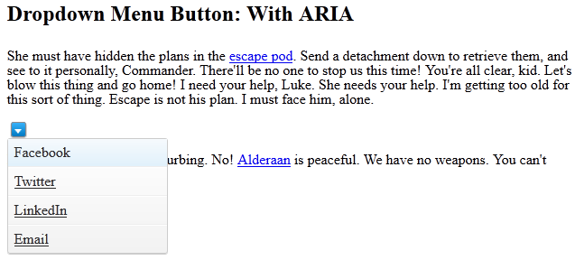
Complex example – demo
Demo URL: http://bit.ly/ZvA9SH
Notes:
Demo URL: http://bit.ly/ZvA9SH

Slide 26

tips
“If you can use a native HTML element or attribute instead of an ARIA role, state or property, then do so.” -Steve Faulkner Before: <div role=“form”> After: <form>
Notes:
http://www.paciellogroup.com/blog/2012/06/html5-accessibility-chops-using-aria-notes/

Slide 27
tips
Adding an ARIA role overrides the native role semantics. Example: <li role=button>open foo</li> Becomes this in the accessibility tree: <button>open foo</button> If you want both connotations, do this: <li><button>open foo</button></li>

Slide 28
tips
Use role= "presentation" to repair parent-child relationships.
<div role=“menu”>
<ul role=“presentation”>
<li role=“menuitem”>Foo</li>
<li role=“menuitem”>Bar</li>
</ul>
</div>

Slide 29
tips
Don’t use role= "application" unless you’re controlling interaction in every element.
The tab role is not a main navigation tab (ARIA tabs are used with panels to show/hide content).

Slide 30
tips
Adding ARIA attributes inline (landmark, labeling) vs. with script (states, live regions).
Live Regions are great for AJAX/dynamic content.
If the label text is visible on screen, authors SHOULD use aria-labelledby and SHOULD NOT use aria-label.
Keyboard focus() is your friend!

Slide 31
Questions

Slide 32
Contact info
Email: dlembree@paypal.com vtsaran@paypal.com
Twitter Accounts
@DennisL
@Vick08
@PayPalinclusive
Demo URL: http://bit.ly/ZvA9SH

